Slide 1
Electricity and TIG welding

Slide 2
Electric Arc Welding
TIG welding is a kind of the electirc arc welding. Electric power is provided by the electric network. The power coming from the network transformed to the necessary voltage in the welding machine. The welding process is conducted in the electric arc. The temperature the arc generates melts the metal. The different elements melts togheter with an added filler material. In this welding process shielding gas needs to be added too. The gas protects the melted metal from the oxygen and nitrogen in the air.

Slide 3
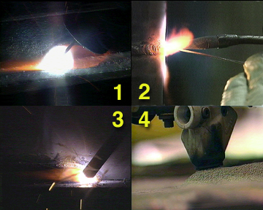
Electric Arc Welding
There are numerous arc welding procedures. See these four procedures.
Wich is NOT arc welding procedure?
1. MiG/MAG welding
2. Gas welding
3. Shielded metal arc welding
4. Submerged arc welding

Slide 4
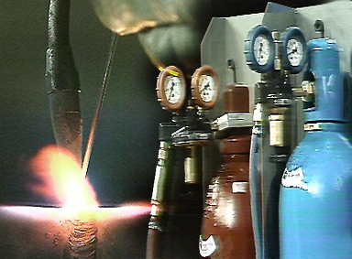
TIG Electric Arc Welding
Solution
2. Gas welding
Only the gas welding is NOT electric arc welding.

Slide 5
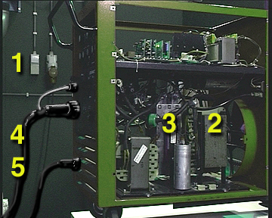
Parts of the TIG welding machine

Slide 6
Electric Arc Welding
Here is a generic TIG welding machine. The machine is connected to a 415 Volts 3-phase network. The power coming from the network transformed to the necessary voltage in the welding machine. With this machine you can weld with two different currents: Alternating current (AC) and Direct Current (DC)
In case of DC welding 415 voltage is transformed to lower voltage, then demodulate it to direct current. This process gives a lower voltage and higher amperage dicect current.
In case of AC welding, the high voltage is transformed to a lower value.
This type of welding machine is called AC/DC power supply.
Notes:
6

Slide 7
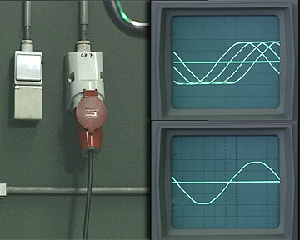
Parts of the TIG Welding equipment
1.
Generally, the machine is connected to a 400 V 3-phase network.
There are TIG machines that can be connected to 1 phase and a cable. In this case, the required voltage is 240 V.

Slide 8
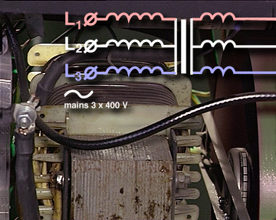
Parts of the TIG Welding equipment
2.
The network current is transformed a more secure lower voltage. At direct current, the voltage is lower than 120 V, at alternating current it is lower than 50 V.

Slide 9
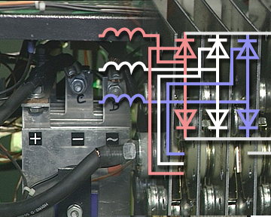
Parts of the TIG Welding equipment
3.
The rectifier uses diodes to demodulate the alternating current into a direct current. The diodes are semi conductors allowing only the positive or the negative part of the alternating current get through.

Slide 10
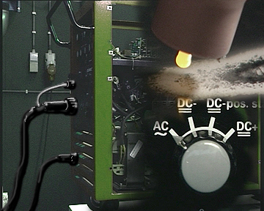
Parts of the TIG Welding equipment
4.
You can weld with alternating current with an AC/DC power supply. In this case, the current does not go through the rectifier. To keep the arc alive high frequency is used because the arc has to be re ignited again and again.

Slide 11
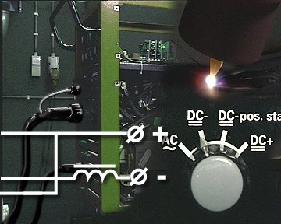
Parts of the TIG Welding equipment
5.
The current alternates between 0,5 and 600 Ampers. The voltage - for security reasons – is maximised to 120 V in Europe.
This security is the great advantage of TIG welding. Besides, the diameter of the elctrode and the heat devoured by the material can be set very precisely by changing the amper settings.

Slide 12
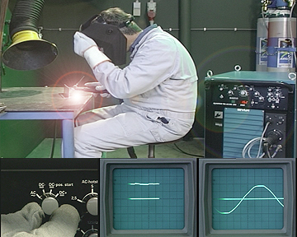
What is the safe voltage on the secondary (heat) side in TIG Welding?
AC, 40 V
DC, 40 V
AC, 240 V
DC, 240 V

Slide 13
solution
Alternating current, 40 V
Direct current, 40 V
For an AC/DC power supply the maximal secure voltage is
- AC 50 V
- DC 120 V

Slide 14
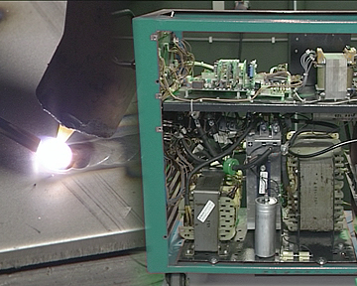
The welding arc
The electric power turing into heat and light in the electric arc. The bigger part is heat.
How is it done?

Slide 15
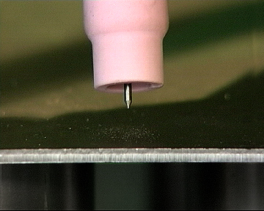
The welding arc
Close the TIG torc to the surface.

Slide 16
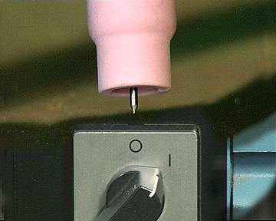
The welding arc
Power should be swithced on. The electriciy transformed in the power supply and gets to the torch.

Slide 17
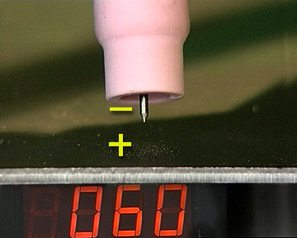
The welding arc
There is a difference in voltage between the eletrode and the surface of the material.
Generally, the electrode is in negative and the surface is in positive state.

Slide 18
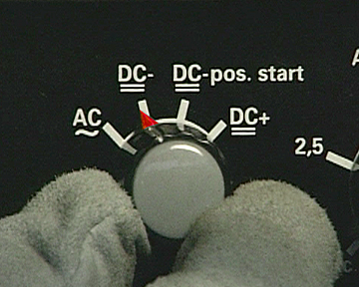
The welding arc
The welding machine is set to provide direct current.

Slide 19
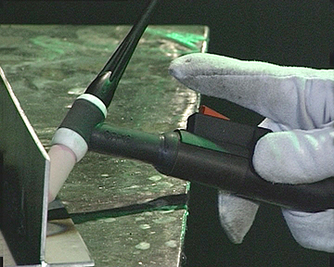
The welding arc
When we set the switch on, then numbers of circuits will be active.

Slide 20
The welding arc
The shielding gas flows out of the torch.

Slide 21
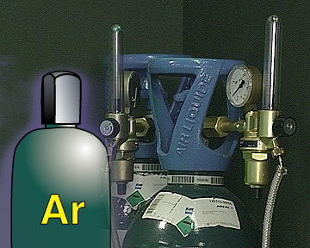
The welding arc
The shielding gas is mostly Argon.

Slide 22
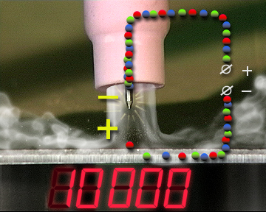
The welding arc
The voltage between the surface and the electrode can be increased with a high frequency generator up to as high as 10 000 Volts.

Slide 23
The welding arc
As a consequence, sparks are born between the surface and the electrode.
That is the beginning to burn the arc.

Slide 24
The welding arc
The current starts to flow between the surface and the electrode. The electrons are continuosly streaming to the positive pole from the negative pole.

Slide 25
The welding arc
In this time, when the voltage rises the arc between the electrode and the surface behaves very differently than at lower voltage. The current is stable…

Slide 26
The welding arc
The arc is born. There is a very high electric resistance along the few millimeters distance thus the electricity transfoms into heat.

Slide 27
The welding arc
The highest temperature arises on the positive pole that is the base material.
The metal melts in great part due to the heat of the arc.
Simultaneously the heat increases the inonisation of the gas so its conductivity increases.

