Slide 1
Planning welded Joints

Slide 2
 | Planning welded joints
Step One | Please pair the explanations with the photos on the next page
Step Two | 2. The Trainer introduces the common forms of welded joints used in industrial practice. The learners need to identify the methods used to prepare each joint on the photos.

Slide 3
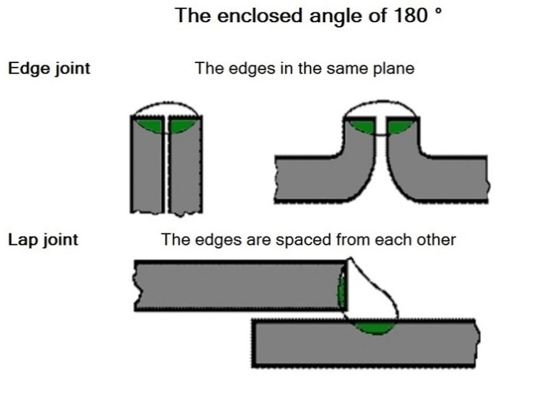
Pair the pictures with their names
A
D
B
C
Corner Joint
Angle Joint
Butt joint
Paralell Joint

Slide 4
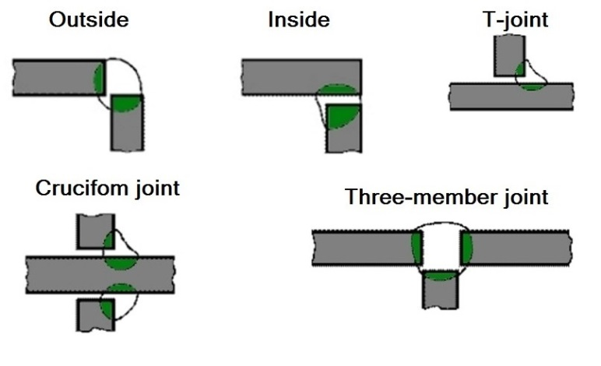
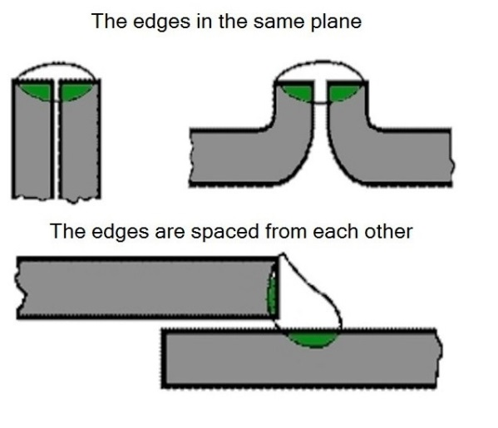
Solutions
A
D
B
C
Corner Joint - D
Angle Joint - B
Butt joint - A
Paralell Joint - C

Slide 5
 | Planned Weld Joints
 | Welded joints The naming of the joints is based on the relative positions of the parts to be joined. Thus, these names refer to the form of the connections. The weld is part of the joint.
 | Butt Joint
 | Corner Joint outside
 | Corner Joint - inside
 | Corner Joint T shape
 | Corner Joint – Double T shape
 | Corner Joint with 3 elements
 | Paralell joint – Edge weld
 | Paralell joint – Edge weld II
 | Paralell joint – overlapping weld
 | Angle joint I
 | Angle Joint II

Slide 6
Butt joint

Slide 7
Corner joint - outside

Slide 8
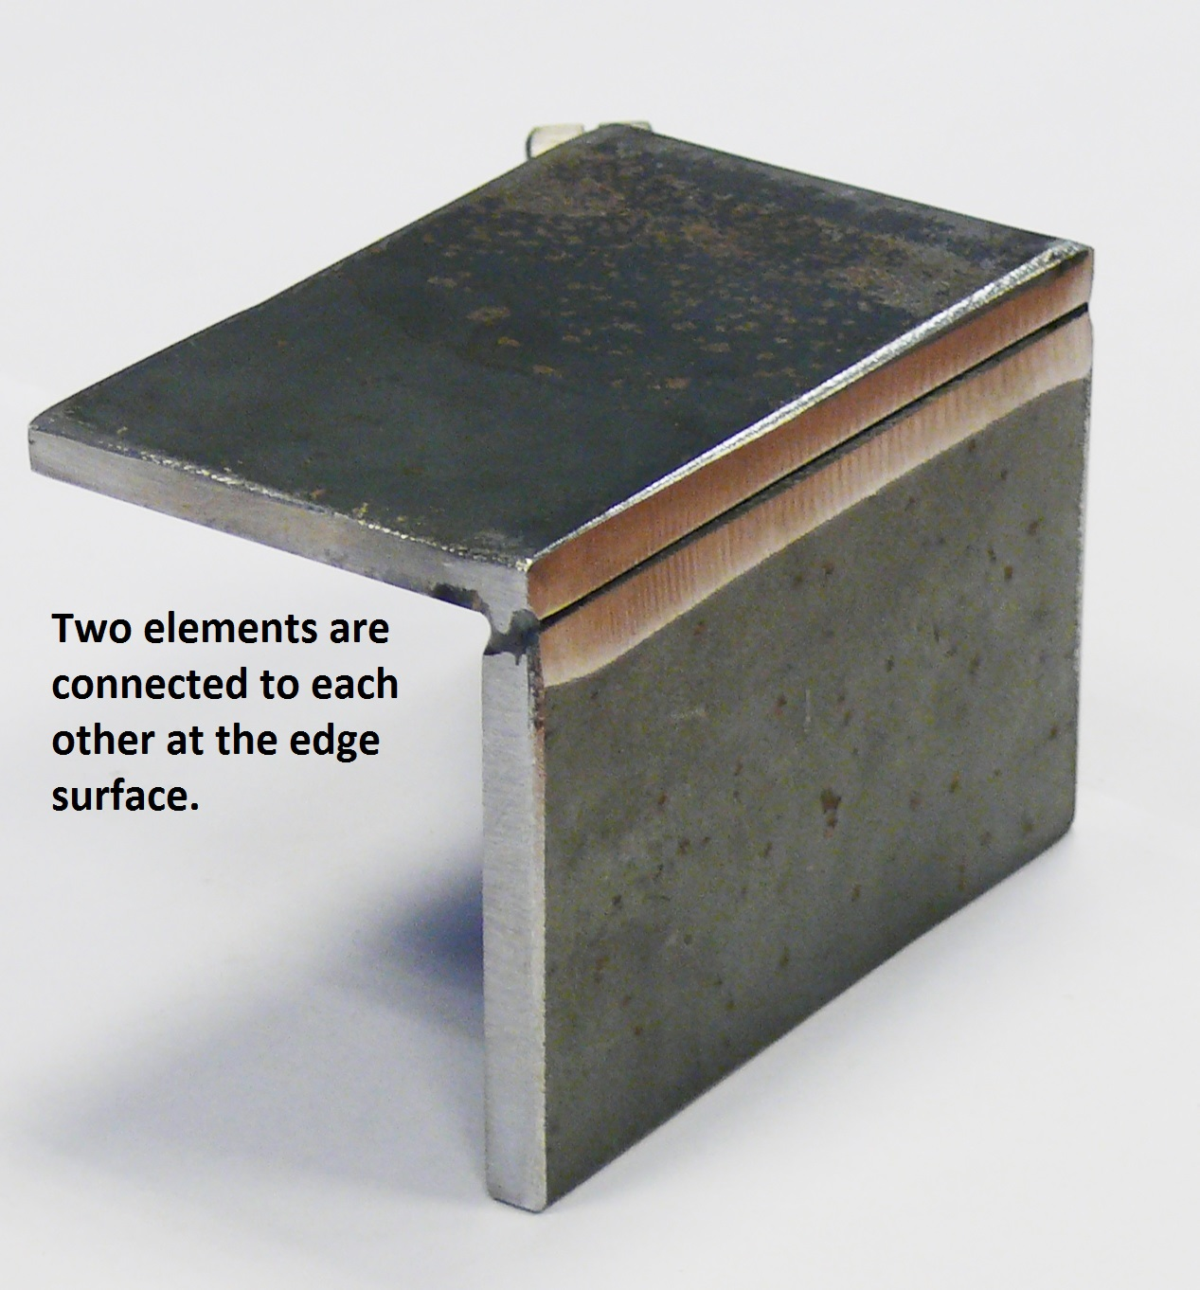
Corner joint - inside

Slide 9
Corner joint T shape

Slide 10
Corner joint – double T shape

Slide 11
Corner joint with 3 elements

Slide 12
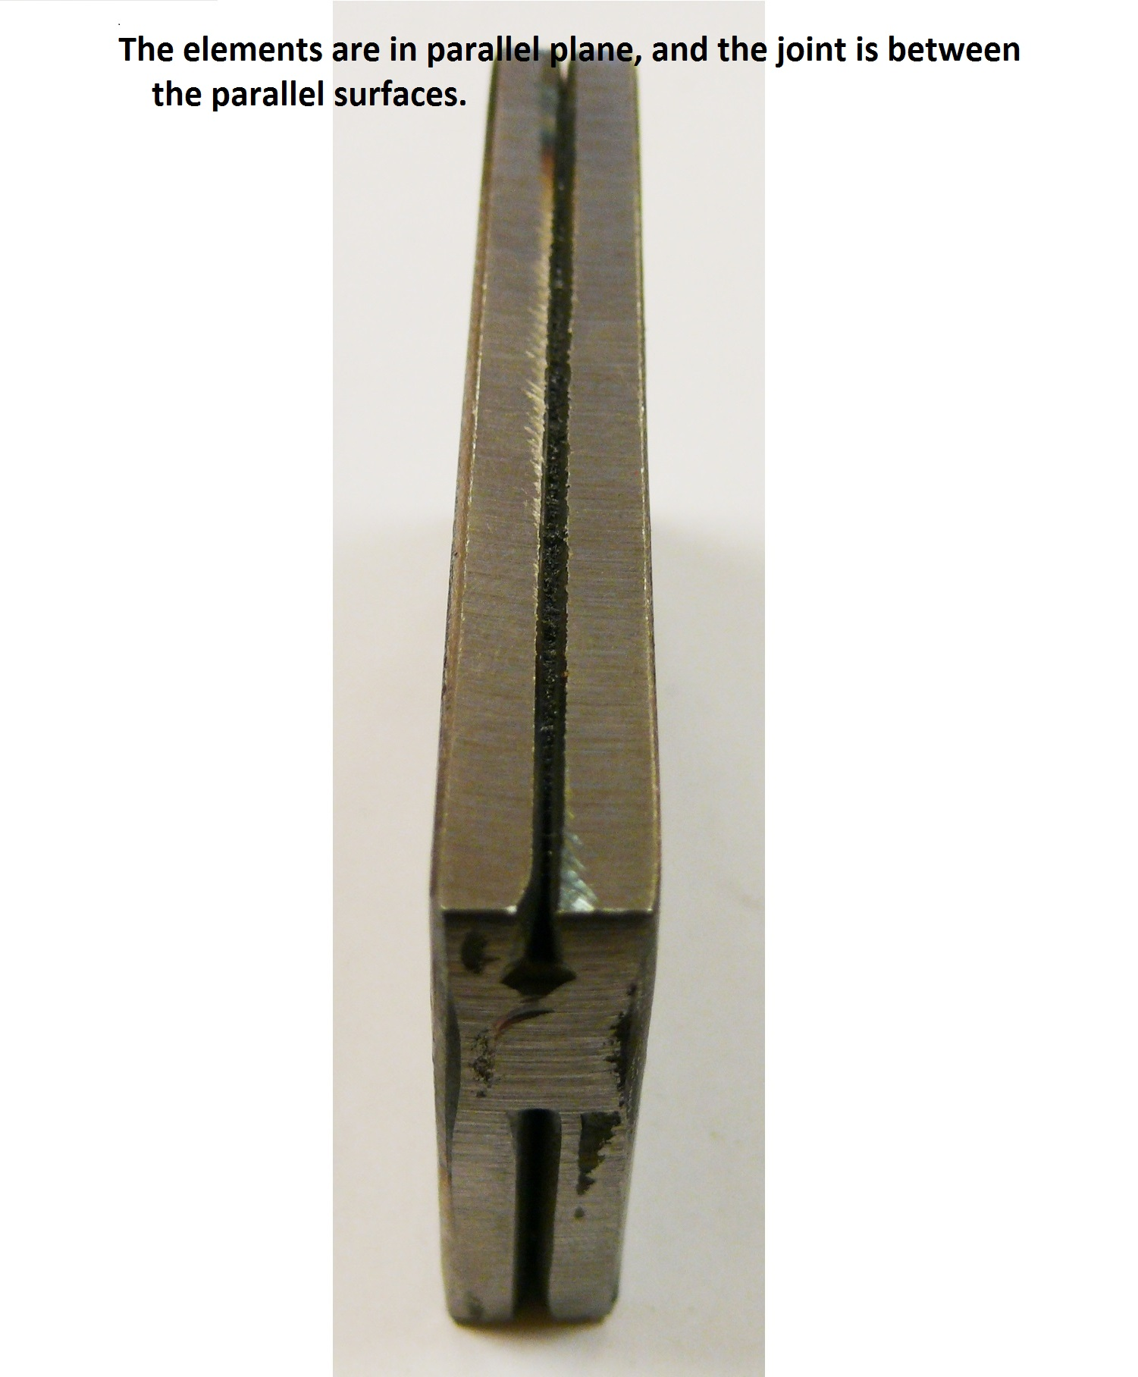
Paralell joint – Edge weld

Slide 13
Paralell joint – Edge weld II

Slide 14
Paralell joint – overlapping weld

Slide 15
Angle joint I

Slide 16
Angle joint II

