Slide 1
Deviation of welded joints and destroying and non-destroying testing processes

Slide 2
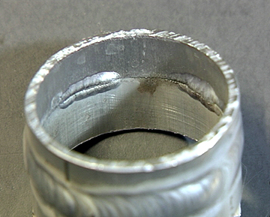
Deviations in welding
Numerous factors can cause deviations in the welding process. Deviations could be perfectly avoided by properly setting the welding parameters.
According to the standard EN ISO 6520 these are the main categories of deviations.
100 Cracks
200 Porostiy
300 Solid inclusions
400 Lack of fusion / insufficient penetration
500 Geometric deivations
600 Other deviations

Slide 3
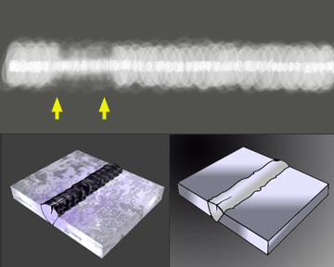
100. Cracks
Crack may occur because of cooling down or tension. They are longitudinal or transverse cracks, inside the heat affected zone or inside the material.

Slide 4
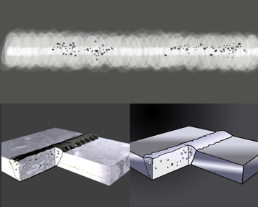
200. Porosity
In a weld, porosity may occur by the lack or interruption of the shielding gas. Sometimes you can see porosity on the surface. Porosity on the X-ray screen is depicted as dark, round spots. They are gassholes or gas-canals.

Slide 5
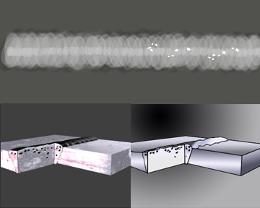
300. Solid inclusions
Solid inclusions occur in many variations. On the X-ray you can see particles of tungsten like white, irregular spots. They arise when the electrode touches the weldpool.

Slide 6
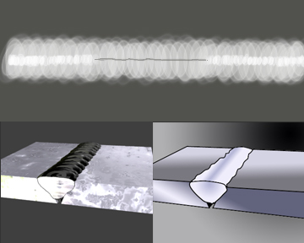
400. Lack of fusion/ insufficient penetration
Lack of fusion/ insufficient penetration is mostly caused by insufficient skills of the welder. See an example of a local insufficient penetration on the X-ray below. The sharp edges of the v-joint are not melted and clearly visible as a grey line.

Slide 7
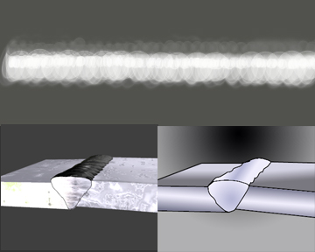
500. Geometric deviations
A frequent geometric deviation is the out-of-line positioning of the pieces. It’s commonly called high-low. The deviation is usually caused by the welder. On the X-ray we see black and white differences between one and the other side the weld.

Slide 8
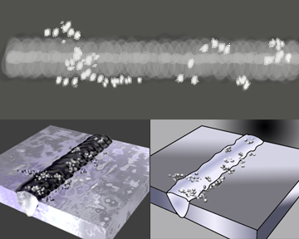
600. Other deviations
The deviations that could not be classified above belong here. In our example we show spatter. Spatter unlikely occurs in TIG welding, since TIG welding is basically a splatterfree process.

Slide 9
Testing processes
Non-destructive testing
Destrucitve testing

Slide 10
1.1 Visual examination
In a visual examination, the weld is examined on deviations such as the correct a-value, undercut, convexity, excessive weld metal, etc. The acceptable deviation for steels are given in the standard EN 5817.

Slide 11
1.2 Surface crack examination
Two methods are used to find surface cracks: magnetic and dye penetrant examination.
In magnetic examination a liquid containing iron powder is sprayed on the weld. When a strong magnetic field is applied cracks are made visible even under the surface.
In dye test, a red liquid is used to soak the weld. The cracks are visible when a white indicator liquid is added.

Slide 12
1.3 X-ray examination
The base material and the weld are examined with X-rays. The result is recorded on a radiation sensitive screen. –Even with little practice the imperfections are easily recogniseable. X-ray is the most common way of identifying welding deviations in quality assurance.

Slide 13
1.4 Ultrasonic examination
In ultrasonic examination the weld is examined by using high-frequency directional sound waves. It works with an emitter-receiver, in which the receiver registers an echo with which you can clearly recognise slag inclusions, lack of fusion and others.
It is a very precise technique to find the location and dimensions of the deviation.

Slide 14
2. Destructive examinations
For destructive examination parts of the workpiece and the weld must be prepared. Test pieces are taken from the weld and machined. In some cases, these test pieces are further prepared by making a local reduced section, a making notch in the surface or polishing the surface.
One special way is breaking the test piece under normal temperature.

Slide 15
2.1 Fracture test
The fracture test is mainly applied for fillet welds. It is a quick test that shows whether the fillet weld has a good penetraion and whether there is lack of fusion. The judgement requires expertise (EN1320)

Slide 16
2.2. Macro test
A careful preparation is necessary for producing a macro of a weld cross section. After the necessary saqing and polishing, etchant is applied to the weld. After some time, you will see that the weld and the deviations become such as:
Porosity
Lack fusion
Insufficient penetration

Slide 17
2.3 Hardness test
This test measures the ductility of the joint. Ductility gets lower if the hardness of the weld is too high. The process is called, Vickers hardness test. The unit of hardness given by the test is known as the Vickers Pyramid Number (HV). The pyramid refers to the diamond used in the test. The maximum hardness of a weld for a determined material is prescribed and is given in „HV” value. The locations of the weld to be tested are precisely prescribed too.

Slide 18
2.4 Transverse tensile test
For a butt weld the fusion between weld and base material can be tested and measured with a transverse tensile test. The dimensions of the test piece are taken accurately before testing. Finally the load at fracture and the location of the fracture are registered.

Slide 19
2.5 Bend test
The bend test is carried out on a correctly prepared test piece taken from a butt weld. It gives mainly information about the existence of lack of fusion defects in the weld.

Slide 20
2.6 Notch fracture test
This test gives information about the ductility of the welded joint. The test specimen can be taken from different parts of the test piece, it can be taken from the weld and the heat affected zone. In this testpiece a notch is milled, which will or will not be the initiation of the fracture. This examination is done in different temperatures.

