Slide 1
Behaviour of materials in welding
Cracks in welded joints

Slide 2
1. OBJECTIVE | Be aware of the factors and settings leading to cracks for each presented example
2. TEACHING METHODS | Using work groups Sharing ideas about the presented examples within the group Talk about and share ideas between groups
3. DURATION | 1 hour
4. GROUPSIZE | 10-12 persons
5. RESORUCES | Examples made of steel Photos copies of appropriate iron – coal diagrams
6. External conditions (where appropriate)
7. Evaluation (where appropriate) | Tests and Presenting in front of others
8. SUMMARY | Photos Examples List all the measures that could minimize or prevent the causes of failure
9. INSTRUCTIONS | 1.- The trainer should present own photos of cracks for each type of cracks - Explain the most generic crack types that might occur in welded joints - Present and show in details the main crack types in the follonwing classes: A) Cold cracks B) Warm cracks 2.- Identify the distorions presented by the learners - Observe and compare the examples shown. - Sharing observations in the group 3.- The trainer should explain what factors and settings lead to the distorisons for each presented example. - Analyse the causes in the group - List all the measures that could minimize or prevent the causes of failure.

Slide 3
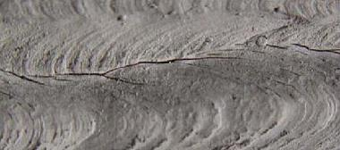
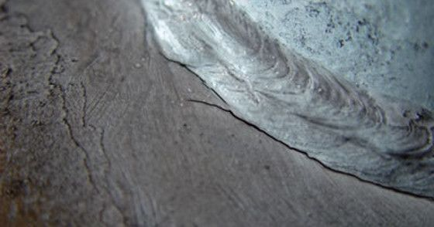
Exercise | Cracking phenomena in welded joints
Solution | Cold cracking is an imperfection that occurs as the result of hydrogen dissolving in the weld metal and then diffusing into the heat affected zone (HAZ), that together with other factors (residual stress and hardened material) can lead to cold cracking. Cold cracks mostly develop long after the weld metal solidifies, but sometimes appear sooner. Cold cracking occurs at temperatures well below 300°C. It is considered a serious welding defect because it can significantly affect the integrity of infrastructure.

Slide 4
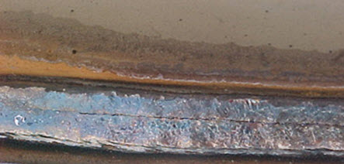
Exercise | Cracking phenomena in welded joints
Solution | Hot cracking, also known as solidification cracking, can occur with all metals, and happens in the fusion zone of a weld. To diminish the probability of this type of cracking, excess material restraint should be avoided, and a proper filler material should be utilized. Other causes include too high welding current, poor joint design that does not diffuse heat, impurities (such as sulfur and phosphorus), preheating, speed is too fast, and long arcs.

