Slide 1
The essence and history of MIG-MAG welding

Slide 2
Essence and history

Slide 3
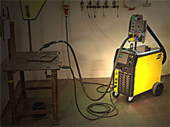
The full equipment

Slide 4
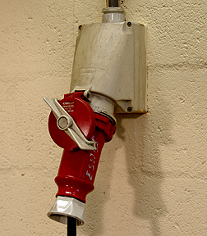
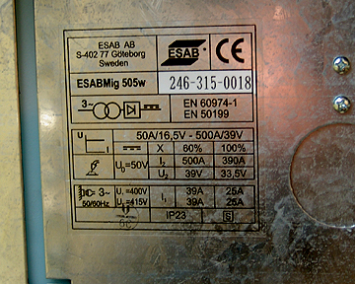
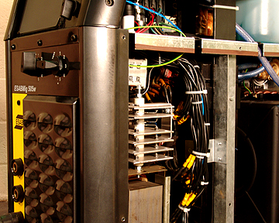
Power source
The power source is transforming down the electricity to the necessary voltage for welding. The machinge contains number of other unints to control the welding arc and the whole process.

Slide 5
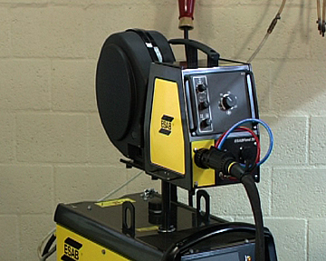
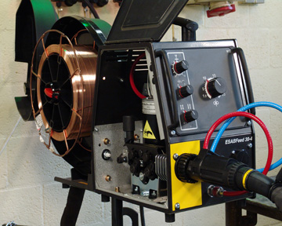
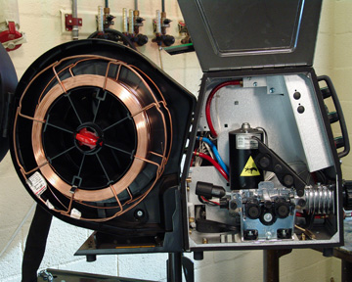
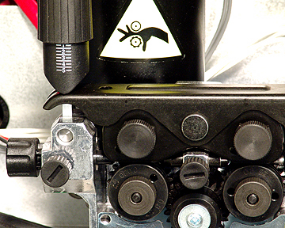
Wire feeder
The filler material in MÍG/MAG welding is a consumable wire electrode mounted on a rolling tape. A small motor spins rollers that feed the wire into the batch of cables from the tape.
In many cases, the wire feeder is built in the box of the power supply. This feeder shown in the photos is a detached unit.

Slide 6
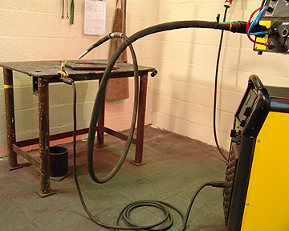
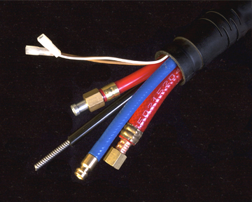
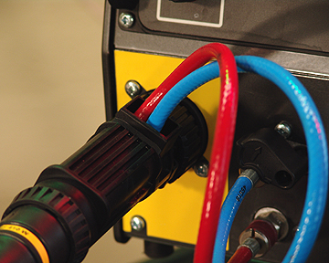
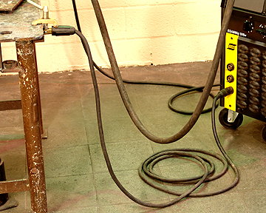
BUNCH OF CABLES
A batch cables connects the power supply, the the tape of wire electrode and the torch. The batch has a flexible tube for the wire electrode and it contains the power cable, the torch control cable, the shield gas tube and the water cooler input output tubes.

Slide 7
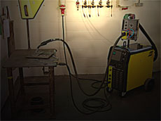
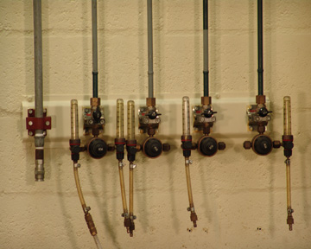
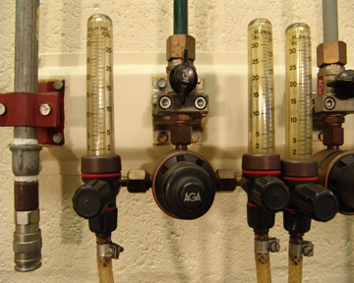
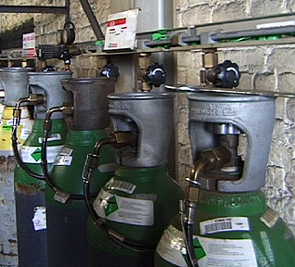
SHIELDING GAS
The shielding gas comes from the central unit and goes out throug the torch. The shielding gas protects the wire electrode, the arc and the weld area from oxygen and vapour. Without shielding gas the weld could consume oxygen and nitrogen from air and damage the weld. The gas can come from a central supply or a gas bottle.

Slide 8
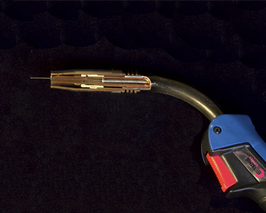
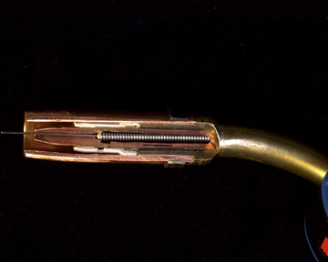
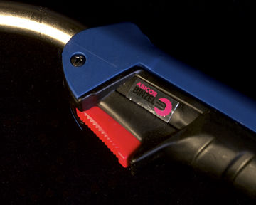
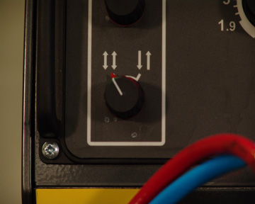
WELDING TORCH
The torch is hand tool of the welding equipment.
There is an on/off switchs is on the torch. If it is switched on the the power is on, the gas stream starts and the feeder starts pushing the consumable wire electrode. When the electrode touches the metal object, an electric arc borns and the welding process begins. When swithced off, the power is off, the gas and the wire feeds are off. The weldning process stops.

Slide 9
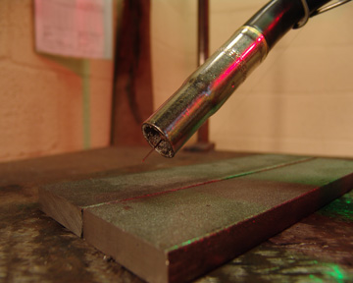
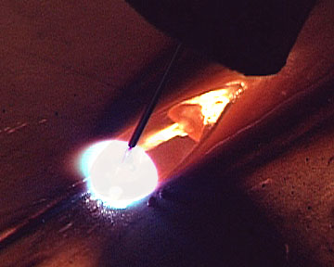
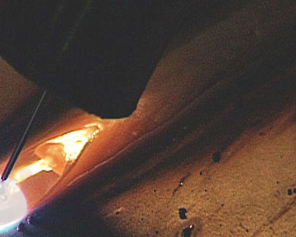
WIRE, ARC, weld pool, weld
The wire works as a conductor between the torch and the arc. At the arc, the wire heats up to melting and the resulting metal drops fall onto the partly meltening metal creating the weld pool.

Slide 10
THE ARC
The arc arises between the end of the wire and the weld pool.
The melted material goes through the arc to the weld pool.
The heat of the arc is considerably high.
In the MIG/MAG welding process the arc and the heat can be fully controlled.

Slide 11
Weld pool
The heat arising in the arc melts the material and becomes the one part of the weld pool.
The two pieces needed to joint melt together with the material of the electrode creating the weld.

Slide 12
THE WELD
The melted weld material and the material of the electrode together create a new part. This is the weld.
Basically, this joint has similar attributes to the material of the welded material.

